Slide 1

This Month’s S.W.A.P. song is:
This Month’s S.W.A.P. song is:
This Photo by Unknown Author is licensed under CC BY-NC-SA

Slide 2
I AM THINE, O LORD

Slide 3
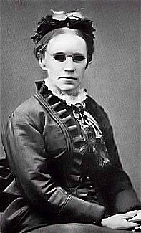
I AM THINE, O LORD
Fanny Crosby
(1820–1915)
Frances Jane van Alstyne (March 24, 1820 – February 12, 1915), more commonly known as Fanny Crosby, was an American mission worker, poet, lyricist, and composer. She was one of the most prolific hymnists in history, writing more than 8,000 hymns and gospel songs, with more than 100 million copies printed, despite being blind from shortly after birth. She is also known for her teaching and her rescue mission work. By the end of the 19th century, she was a household name.
Frances Jane Crosby s born on March 24, 1820 in the village of Brewster, about 50 miles (80 km) north of New York City. She was the only child of John Crosby and his second wife Mercy Crosby, both of whom were relatives of Revolutionary War spy Enoch Crosby. Crosby was proud of her Puritan heritage. She traced her ancestry from Anna Brigham and Simon Crosby who arrived in Boston in 1635 (and were among the founders of Harvard College); their descendants married into Mayflower families. At six weeks old, Crosby caught a cold and developed inflammation of the eyes. Mustard poultices were applied to treat the discharges. According to Crosby, this procedure damaged her optic nerves and blinded her, but modern physicians think that her blindness was more likely congenital and, given her age, may simply not have been noticed by her parents.
.John Crosby died in November 1820 when Fanny was only six months old, so she was raised by her mother and maternal grandmother Eunice Paddock Crosby (born about 1778; died about 1831). When Crosby was three, the family moved to North Salem, New York where Eunice had been raised. In April 1825, she was examined by Valentine Mott, who concluded that her condition was inoperable and that her blindness was permanent. Crosby enrolled at the New York Institution for the Blind (NYIB) in 1835, just before her 15th birthday. She remained there for eight years as a student, and another two years as a graduate pupil, during which time she learned to play the piano, organ, harp, and guitar, and became a good soprano singer. While she was studying at NYIB in 1838, her mother Mercy remarried and the couple had three children together. Mercy's husband abandoned her in 1844.
Author: Fanny Crosby
Music: W. Howard Doane
Date written: 1875

Slide 4
I AM THINE, O LORD
Biography continued………
Fanny Crosby
(1820–1915)
After graduation from the NYIB in 1843, Crosby joined a group of lobbyists in Washington, D.C. arguing for support of education for the blind. She was the first woman to speak in the United States Senate when she read a poem there. She appeared before the joint houses of Congress and recited these lines:
O ye, who here from every state convene,
Illustrious band! may we not hope the scene
You now behold will prove to every mind
Instruction hath a ray to cheer the blind.
In the summer of 1843, Crosby met Alexander van Alstyne, Jr. (sometimes spelled van Alstine or van Alsteine), called "Van" by his friends. He also was blind and enrolled at the NYIB, where he was a casual acquaintance of Crosby and sometimes a student in her classes.
In April 1846, Crosby spoke before a joint session of the United States Congress, with delegations from the Boston and Philadelphia Institutions for the Blind,] "to advocate support for the education of the blind in Boston, Philadelphia, and New York". She testified before a special congressional subcommittee, and she performed in the music room at the White House for President Polk and his wife. Among the songs that she sang as she accompanied herself on the piano was her own composition:
Our President! We humbly turn to thee –Are not the blind the objects of thy care?
In 1846, Crosby was an instructor at the NYIB and was listed as a "graduate pupil". She subsequently joined the school's faculty, teaching grammar, rhetoric, and history; she remained there until three days before her wedding on March 5, 1858. While teaching at the NYIB, she befriended future US president Grover Cleveland then aged 17. The two spent many hours together at the end of each day, and he often transcribed the poems that she dictated to him. He wrote her a recommendation which was published in her 1906 autobiography. She wrote a poem that was read at the dedication of Cleveland's birthplace in Caldwell, New Jersey in March 1913, being unable to attend due to her health. There was a cholera epidemic in New York City from May to November 1849, and she remained at the NYIB to nurse the sick rather than leaving the city. Subsequently, according to Blumhofer, "Crosby seemed worn, languid, even depressed" when the Institution re-opened in November, forcing her to teach a lighter load. According to Bernard Ruffin: In this atmosphere of death and gloom, Fanny became increasingly introspective over her soul’s welfare. She began to realize that something was lacking in her spiritual life. She knew that she had gotten wrapped up in social, political, and educational reform, and did not have a true love for God in her heart.
Author: Fanny Crosby
Music: W. Howard Doane
Date written: 1875

Slide 5
I AM THINE, O LORD
Biography continued………
Fanny Crosby
(1820–1915)
In 1859, the van Alstynes had a daughter named Frances who died in her sleep soon after birth. Some believe that the cause was typhoid fever, although Darlene Neptune speculates that it may have been SIDS, and that Crosby's hymn "Safe in the Arms of Jesus" was inspired by her death.
After the death of their daughter, Van became increasingly reclusive; Crosby never spoke publicly about being a mother, aside from mentioning it in a few interviews towards the end of her life: "Now I am going to tell you of something that only my closest friends know. I became a mother and knew a mother's love. God gave us a tender babe but the angels came down and took our infant up to God and to His throne". In late 1859, the van Alstynes moved frequently, "establishing a pattern that continued for the rest of their lives", and never owned their own home, living in rented accommodation without a lease. Crosby attended churches of various denominations until spring 1887. In 1877, Crosby met William J. Kirkpatrick, one of the most prolific composers of gospel song tunes] and "the most prominent publisher in the Wesleyan/Holiness Movement". She called him "Kirkie" and wrote many hymns with him. Some of her hymns reflected her Wesleyan beliefs, including her call to consecrated Christian living in "I Am Thine, O Lord" (1875)
Crosby was "the most prolific of all nineteenth-century American sacred song writers". By the end of her career she had written almost 9,000 hymns. It is estimated that books containing her lyrics sold 100 million copies. Crosby set a goal of winning a million people to Christ through her hymns, and whenever she wrote a hymn she prayed it would bring women and men to Christ, and kept careful records of those reported to have been saved through her hymns. Many of Fanny’s hymns emerged from her involvement in the city missions, including "More Like Jesus" (1867), "Pass Me Not, O Gentle Saviour" (1868), and "Rescue the Perishing" (1869), which became the "theme song of the home missions movement"] and was "perhaps the most popular city mission song", with its "wedding of personal piety and compassion for humanity". She celebrated the rescue mission movement in her 1895 hymn "The Rescue Band".
Crosby's hymn writing declined in later years, but she was active in speaking engagements and missionary work among America's urban poor almost until she died. She was well known, and she often met with presidents, generals, and other dignitaries.
Crosby died at Bridgeport of arteriosclerosis and a cerebral hemorrhage on February 12, 1915 after a six-month illness, aged 94. She was buried at Mountain Grove Cemetery in Bridgeport, CT near her mother and other members of her family. Her family erected a very small tombstone at her request which carried the words: "Aunt Fanny: She hath done what she could; Fanny J. Crosby".
Author: Fanny Crosby
Music: W. Howard Doane
Date written: 1875

Slide 6
Song Lyrics:
I am Thine, O Lord, I have heard Thy voice,
And it told Thy love to me;
But I long to rise in the arms of faith,
And be closer drawn to Thee.
Refrain
Draw me nearer, nearer, blessed Lord,
To the cross where Thou hast died;
Draw me nearer, nearer, nearer, blessed Lord,
To Thy precious, bleeding side.
Refrain
Consecrate me now to Thy service, Lord,
By the pow’r of grace divine;
Let my soul look up with a steadfast hope,
And my will be lost in Thine.
Refrain
O the pure delight of a single hour
That before Thy throne I spend,
When I kneel in prayer, and with Thee, my God,
I commune as friend with friend!
Refrain
There are depths of love that I yet may know
Ere Thee face to face I see;
There are heights of joy that I yet may reach
Ere I rest in peace with Thee.
I AM THINE, O LORD
The Word on Drawing near to God:
Luke 9:23
And he said to [them] all, If any [man] will come after me, let him deny himself, and take up his cross daily, and follow me.
Hebrews 10:22:
Let us draw near with a true heart in full assurance of faith, having our hearts sprinkled from an evil conscience, and our bodies washed with pure water.
James 4:8
Draw nigh to God, and he will draw nigh to you. Cleanse [your] hands, [ye] sinners; and purify [your] hearts, [ye] double minded.

Slide 7
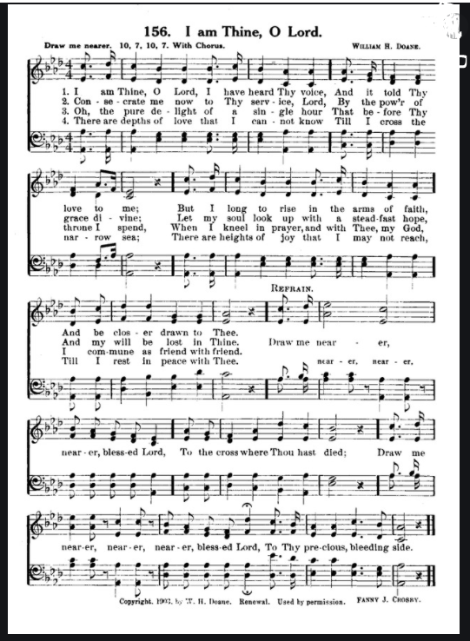

I AM THINE, O LORD
Hear song played
Hear song performed

Slide 8
I AM THINE, O LORD
Ask yourself……
In what ways can you draw nearer to God now?
(Merriam-Webster)
Draw:
to cause to move continuously toward or after a force applied in advance
to move (something, such as a covering) over or to one side
to cause to go in a certain direction (as by leading)
to bring in or gather from a specified group or area
to bring out by way of response

