Slide 1

This Month’s S.W.A.P. song is:
This Month’s S.W.A.P. song is:
This Photo by Unknown Author is licensed under CC BY-NC-SA

Slide 2
WHEN WE ALL GET TO HEAVEN

Slide 3
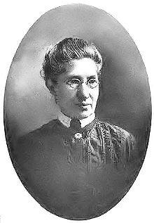
When we all get to heaven
Eliza E. Hewitt
(1851-1920)
Author: Eliza E. Hewitt
Music: Emily D. Wilson
Date written: 1898
MISS ELIZA EDMUNDS HEWITT was born in Philadelphia, Pa., June 28, 1851. She was educated in the Public Schools of that city and after graduation from the Girls’ High School, obtained a position as teacher. This career was cut short by the development of a spinal malady, which caused her to be a shut-in sufferer for many years. In course of time, a gradual improvement came about, and during a slow convalescence, the study of English literature, as in school-girl days, was her great delight. Wishing to be helpful to her Church, she wrote poems for its primary department, some of which attracted the attention of Prof. Jno. R. Sweney, at one time chorister of that church. However, writing did not fill all her desires for usefulness in the Master’s service, and it has been her privilege for some years, to be engaged in primary Sunday School work, and to take an active part in the Philadelphia Elementary Union. At present, she is Superintendent of the primary department of the Calvin Presbyterian church. There is no place where she is happier than in her beloved primary room, surrounded by her bright young teachers and loving scholars. In connection with this work, Miss Hewitt has contributed to various Sunday school periodicals, providing for the Reformed church its Golden Text stories and lesson suggestions.
Miss Hewitt’s hymns are the result of inspiration, the origin of which, to her, is often mysterious; she has never cared to keep a record, but their number is known to have passed into the thousands. The hymn, “Sunshine In My Soul,” was given wings, and circled the globe, coming back to its author with many beautiful stories of its use. The same is true of other of her hymns. Among the most popular have been, “Sunshine In My Soul,” “Will There Be Any Stars?” “Stepping in the Light,” “Not One Forgotten,” “More About Jesus,” “The Very Same Jesus.”
It was a glad day when Miss Hewitt met Fanny Crosby and their mutual love is a joy to both. During a visit to the Indians of the Onondaga Reservation, she was adopted into their tribe, and this relationship has led to unique and pleasant experiences. “After all, what hymns are so dear to us as the old church favorites? In looking over my life, would humbly and gratefully say: ’Tis grace has brought me safe thus far, and grace will lead me home.”
by Charles Gabriel
The Singers and Their Songs (1916)

Slide 4
When we all get to heaven
Song Lyrics:
Sing the wondrous love of Jesus,
Sing His mercy and His grace.
In the mansions bright and blessed
He’ll prepare for us a place.
Refrain
When we all get to Heaven,
What a day of rejoicing that will be!
When we all see Jesus,
We’ll sing and shout the victory!
While we walk the pilgrim pathway,
Clouds will overspread the sky;
But when traveling days are over,
Not a shadow, not a sigh.
Refrain
Let us then be true and faithful,
Trusting, serving every day;
Just one glimpse of Him in glory
Will the toils of life repay.
Refrain
Onward to the prize before us!
Soon His beauty we’ll behold;
Soon the pearly gates will open;
We shall tread the streets of gold.
Refrain
The Word on Heaven:
Matthew 6:19-21 Lay not up for yourselves treasures upon earth, where moth and rust doth corrupt, and where thieves break through and steal: ²⁰ But lay up for yourselves treasures in heaven, where neither moth nor rust doth corrupt, and where thieves do not break through nor steal:²¹ For where your treasure is, there will your heart be also.
1 Corinthians 2:9- But as it is written, Eye hath not seen, nor ear heard, neither have entered into the heart of man, the things which God hath prepared for them that love him.

Slide 5
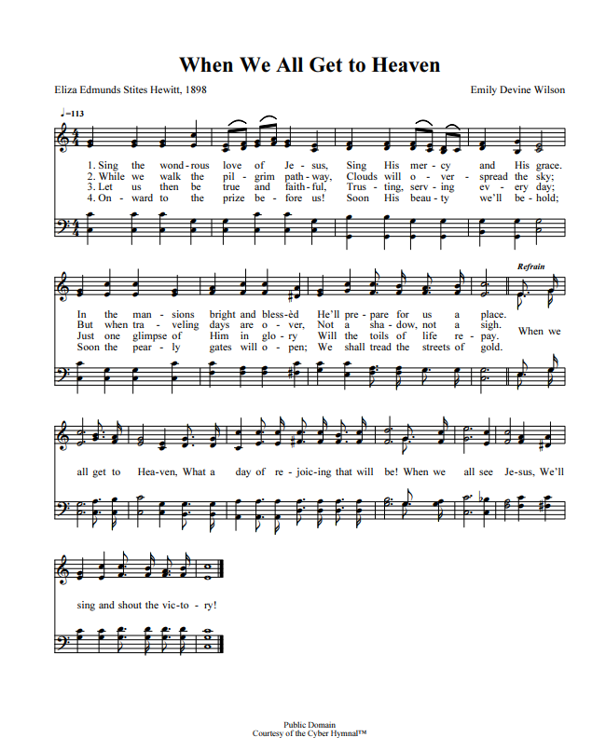

When we all get to heaven
Hear song played
Hear song performed

Slide 6
Ask yourself……
Is there anything that would keep you here if you were called to Heaven today? Where are your treasures truly?

